Slide 1
CSE 2233 Theory of Computing
Shekh. Md. Saifur Rahman
Lecturer, CSE Department
UIU

Slide 2
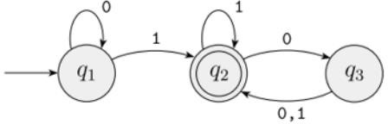
Deterministic Finite Automaton (DFA)
The term “deterministic finite automata” refers to the fact that on each input there is one and only one state to which the automaton can transition from its current state.
Lecturer Saifur Rahman, Dept. of CSE, United International University

Slide 3
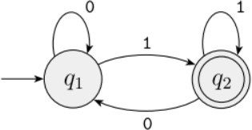
Two state Finite Automaton 𝑀1
Defined by 5-tuple ( Q, 𝛴, 𝛿, Start state, F)
Q = ?
𝛴 = ?
𝛿 = ?
Start state = ?
Accept state, F = ?
L(𝑀1) = ?
Acceptability Check : 01011
Lecturer Saifur Rahman, Dept. of CSE, United International University

Slide 4
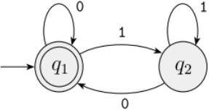
Two state Finite Automaton 𝑀2
Defined by 5-tuple ( Q, 𝛴, 𝛿, Start state, F)
Q = ?
𝛴 = ?
𝛿 = ?
Start state = ?
Accept state, F = ?
L(𝑀2) = ?
Acceptability Check :
Lecturer Saifur Rahman, Dept. of CSE, United International University

Slide 5
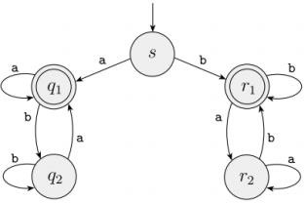
Finite Automaton 𝑀3
Defined by 5-tuple ( Q, 𝛴, 𝛿, Start state, F)
Q = ?
𝛴 = ?
𝛿 = ?
Start state = ?
Accept state, F = ?
L(𝑀3) = ?
Acceptability Check :
Lecturer Saifur Rahman, Dept. of CSE, United International University

Slide 6
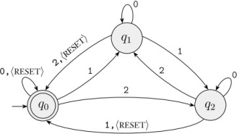
Finite Automaton 𝑀4
Defined by 5-tuple ( Q, 𝛴, 𝛿, Start state, F)
Q = ?
𝛴 = ?
𝛿 = ?
Start state = ?
Accept state, F = ?
L(𝑀4) = ?
Acceptability Check :
Lecturer Saifur Rahman, Dept. of CSE, United International University

Slide 7
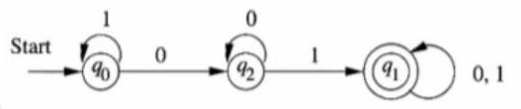
Finite Automaton 𝑀5
Defined by 5-tuple ( Q, 𝛴, 𝛿, Start state, F)
Q = ?
𝛴 = ?
𝛿 = ?
Start state = ?
Accept state, F = ?
L(𝑀5) = ?
Acceptability Check :
Lecturer Saifur Rahman, Dept. of CSE, United International University

Slide 8
Designing Finite Automata
Machine, 𝐸1
Give a DFA for Σ = { 0, 1 } that accepts any language consists of all strings with an odd number of
1s.
Lecturer Saifur Rahman, Dept. of CSE, United International University

Slide 9
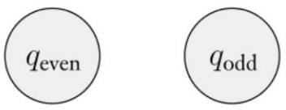
Do we need to remember the entire string seen so far?
Fig: The two states q_{even} and q_{odd}
Simply remember whether the number of 1s seen so far is even or odd and keep track of this information as you read new symbols. If you read a 1, flip the answer; but if you read a 0, leave the answer as is.
Lecturer Saifur Rahman, Dept. of CSE, United International University

Slide 10
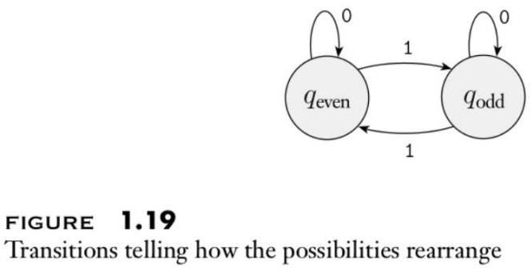
Apply Transitions
Lecturer Saifur Rahman, Dept. of CSE, United International University

Slide 11
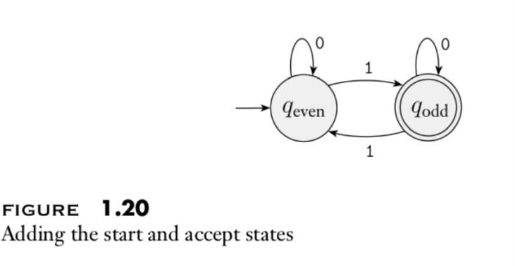
Add accept and reject states
Lecturer Saifur Rahman, Dept. of CSE, United International University

Slide 12
Machine, 𝐸2
Give a DFA for Σ = { 0, 1 } that accepts any string containing any number of 0’s, 1’s or empty string.
Lecturer Saifur Rahman, Dept. of CSE, United International University

Slide 13

Machine, 𝐸2
Give a DFA for Σ = { 0, 1 } that accepts any string containing any number of 0’s, 1’s or empty string.
Lecturer Saifur Rahman, Dept. of CSE, United International University

Slide 14
Machine, 𝐸3
Give a DFA for Σ = { 0, 1 } that accepts any string containing any number of 0’s, 1’s except empty string.
Lecturer Saifur Rahman, Dept. of CSE, United International University

Slide 15
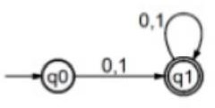
Machine, 𝐸3
Give a DFA for Σ = { 0, 1 } that accepts any string containing any number of 0’s, 1’s except empty string.
Lecturer Saifur Rahman, Dept. of CSE, United International University

Slide 16
Machine, 𝐸4
Give a DFA for Σ = { 0, 1 } that accepts only the empty string.
Lecturer Saifur Rahman, Dept. of CSE, United International University

Slide 17
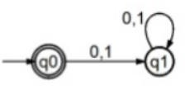
Machine, 𝐸4
Give a DFA for Σ = { 0, 1 } that accepts only the empty string.
Lecturer Saifur Rahman, Dept. of CSE, United International University

Slide 18
Machine, 𝐸5
Give a DFA for Σ = { a, b } and strings that have exact length 2.
Lecturer Saifur Rahman, Dept. of CSE, United International University

Slide 19

Machine, 𝐸5
Give a DFA for Σ = { a, b } and strings that have exact length 2.
Lecturer Saifur Rahman, Dept. of CSE, United International University

Slide 20
Machine, 𝐸6
Give a DFA for Σ = { a, b } and strings that have length at least 3.
Lecturer Saifur Rahman, Dept. of CSE, United International University

Slide 21
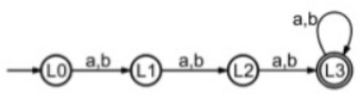
Machine, 𝐸6
Give a DFA for Σ = { a, b } and strings that have length at least 3.
Lecturer Saifur Rahman, Dept. of CSE, United International University

Slide 22
Machine, 𝐸7
Give a DFA for Σ = { a, b } and strings that have length at most 2.
Lecturer Saifur Rahman, Dept. of CSE, United International University

Slide 23



Machine, 𝐸7
Give a DFA for Σ = { a, b } and strings that have length at most 2.
Lecturer Saifur Rahman, Dept. of CSE, United International University

Slide 24
Machine, 𝐸8
Draw a DFA for the language accepting strings starting with ‘a’ over input alphabets Σ = { a, b }.
Lecturer Saifur Rahman, Dept. of CSE, United International University

Slide 25
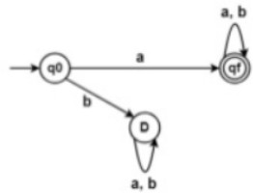
Machine, 𝐸8
Draw a DFA for the language accepting strings starting with ‘a’ over input alphabets Σ = { a, b }.
Lecturer Saifur Rahman, Dept. of CSE, United International University

Slide 26
Machine, 𝐸9
Draw a DFA for the language accepting strings starting with ‘ab’ over input alphabets Σ = { a, b } .
Lecturer Saifur Rahman, Dept. of CSE, United International University

Slide 27
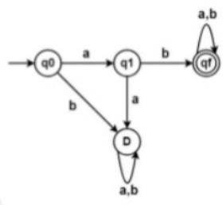
Machine, 𝐸9
Draw a DFA for the language accepting strings starting with ‘ab’ over input alphabets Σ = { a, b } .
Lecturer Saifur Rahman, Dept. of CSE, United International University

Slide 28
Machine, 𝐸10
Draw a DFA for the language accepting strings starting with ‘101’ over input alphabets Σ = { 0, 1 }.
Lecturer Saifur Rahman, Dept. of CSE, United International University

Slide 29
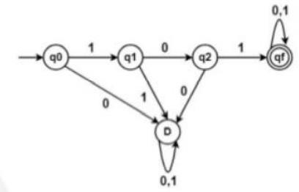
Machine, 𝐸10
Draw a DFA for the language accepting strings starting with ‘101’ over input alphabets Σ = { 0, 1 }.
Lecturer Saifur Rahman, Dept. of CSE, United International University

Slide 30
Machine, 𝐸11
Draw a DFA for the language accepting strings ending with ‘01’ over input alphabets Σ = { 0, 1 }
Lecturer Saifur Rahman, Dept. of CSE, United International University

Slide 31
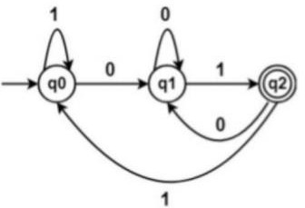
Machine, 𝐸11
Draw a DFA for the language accepting strings ending with ‘01’ over input alphabets Σ = { 0, 1 }
Lecturer Saifur Rahman, Dept. of CSE, United International University

Slide 32
Machine, 𝐸12
Draw a DFA for the language accepting strings ending with ‘abb’ over input alphabets Σ = { a, b }
Lecturer Saifur Rahman, Dept. of CSE, United International University

Slide 33
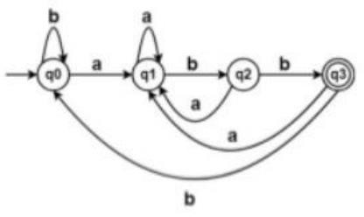
Machine, 𝐸12
Draw a DFA for the language accepting strings ending with ‘abb’ over input alphabets Σ = { a, b }
Lecturer Saifur Rahman, Dept. of CSE, United International University

Slide 34
Machine, 𝐸13
Draw a DFA for the language accepting strings ending with ‘0011’ over input alphabets Σ = { 0, 1 }.
Lecturer Saifur Rahman, Dept. of CSE, United International University

Slide 35
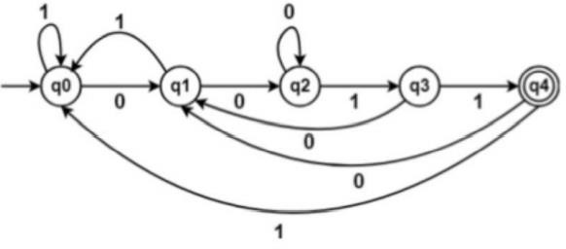
Machine, 𝐸13
Draw a DFA for the language accepting strings ending with ‘0011’ over input alphabets Σ = { 0, 1 }.
Lecturer Saifur Rahman, Dept. of CSE, United International University

Slide 36
Machine, 𝐸14 and 𝐸15
Give a DFA for Σ = { a, b } and strings that have exactly 2 a’s.
Give a DFA for Σ = { a, b } and strings that have at least 2 b’s.
Lecturer Saifur Rahman, Dept. of CSE, United International University

Slide 37


Machine, 𝐸14 and 𝐸15
Give a DFA for Σ = { a, b } and strings that have exactly 2 a’s.
Give a DFA for Σ = { a, b } and strings that have at least 2 b’s.
Lecturer Saifur Rahman, Dept. of CSE, United International University

Slide 38
Machine, 𝐸16
Give a DFA for Σ = { a, b } and the second symbol from the left side is ‘a’.
Lecturer Saifur Rahman, Dept. of CSE, United International University

Slide 39
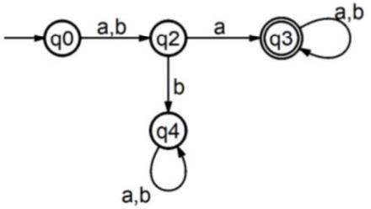
Machine, 𝐸16
Give a DFA for Σ = { a, b } and the second symbol from the left side is ‘a’.
Lecturer Saifur Rahman, Dept. of CSE, United International University

Slide 40
Machine, 𝐸17
Design a finite automaton to recognize the regular language of all strings that contain the string 001 as a substring.
For example, 0010, 1001, 001, and 11111110011111 are all in the language, but 11 and 0000
are not.
Lecturer Saifur Rahman, Dept. of CSE, United International University

Slide 41
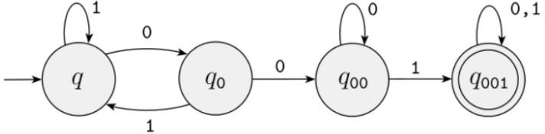
Machine, 𝐸17
Design a finite automaton to recognize the regular language of all strings that contain the string 001 as a substring.
For example, 0010, 1001, 001, and 11111110011111 are all in the language, but 11 and 0000
are not.
Lecturer Saifur Rahman, Dept. of CSE, United International University

Slide 42
Machine, 𝐸18 and E19
Design a finite automaton to recognize the regular language of all strings that contain the string abca as a substring.
Design a finite automaton to recognize the regular language of all strings that contain the string abababa as a substring.
Lecturer Saifur Rahman, Dept. of CSE, United International University

Slide 43
Machine, 𝐸18 and E19
Design a finite automaton to recognize the regular language of all strings that contain the string abca as a substring.
Design a finite automaton to recognize the regular language of all strings that contain the string abababa as a substring.
Lecturer Saifur Rahman, Dept. of CSE, United International University

Slide 44
Machine, 𝐸20, E21 and E22
Draw a DFA for the language accepting strings that do not start with ‘ab’ over input alphabets Σ = { a, b }.
Draw a DFA for the language accepting strings that do not end with ‘abb’ over input alphabets Σ = { a, b }.
Design a finite automaton to recognize the regular language of all strings that do not contain the string 001 as a substring.
Lecturer Saifur Rahman, Dept. of CSE, United International University

Slide 45
Machine, 𝐸23
Give a DFA for Σ = { 0, 1 } that accepts only those strings (including empty string) whose length is a multiple of 3.
Lecturer Saifur Rahman, Dept. of CSE, United International University

Slide 46
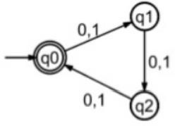


Machine, 𝐸23
Give a DFA for Σ = { 0, 1 } that accepts only those strings (including empty string) whose length is a multiple of 3.
Lecturer Saifur Rahman, Dept. of CSE, United International University

Slide 47
Machine, 𝐸24
Give a DFA for Σ = { 0, 1 } and strings that contain any number of 0’s and the total number of 1’s is a multiple of 3.
Lecturer Saifur Rahman, Dept. of CSE, United International University

Slide 48
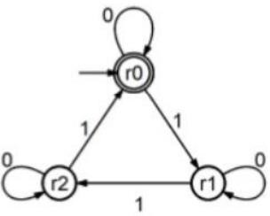
Machine, 𝐸24
Give a DFA for Σ = { 0, 1 } and strings that contain any number of 0’s and the total number of 1’s is a multiple of 3.
Lecturer Saifur Rahman, Dept. of CSE, United International University

Slide 49
Machine, 𝐸25
Give a DFA for Σ = { 0, 1 } and only accepts binary strings those are a multiple of 3.
Lecturer Saifur Rahman, Dept. of CSE, United International University

Slide 50
Machine, 𝐸26
Give a DFA for Σ = { 0, 1, 2, 3, 4, 5, 6, 7, 8, 9 } that accepts strings whose decimal equivalent is a
multiple of 3
Lecturer Saifur Rahman, Dept. of CSE, United International University

Slide 51
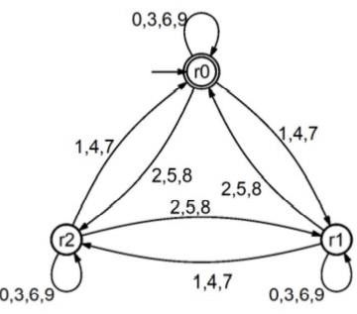
Machine, 𝐸26
Give a DFA for Σ = { 0, 1, 2, 3, 4, 5, 6, 7, 8, 9 } that accepts strings whose decimal equivalent is a
multiple of 3
Lecturer Saifur Rahman, Dept. of CSE, United International University

Slide 52
Machine, 𝐸27
Give a DFA for Σ = { a, b, c } and recognizes strings having patterns = {𝑎^{n}𝑏^{𝑚}𝑐^{𝑙} | n,m,l >= 0 }
Lecturer Saifur Rahman, Dept. of CSE, United International University

Slide 53
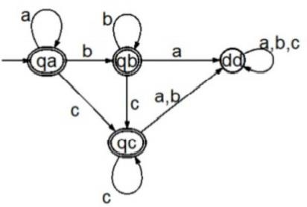
Machine, 𝐸27
Give a DFA for Σ = { a, b, c } and recognizes strings having patterns = {𝑎^{n}𝑏^{𝑚}𝑐^{𝑙} | n,m,l >= 0 }
Lecturer Saifur Rahman, Dept. of CSE, United International University

Slide 54
Machine, 𝐸28
Give a DFA for Σ = { a, b } and contains strings where each ‘a’ is followed by ‘bb’
Lecturer Saifur Rahman, Dept. of CSE, United International University

Slide 55
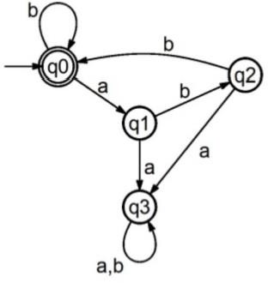
Machine, 𝐸28
Give a DFA for Σ = { a, b } and contains strings where each ‘a’ is followed by ‘bb’
Lecturer Saifur Rahman, Dept. of CSE, United International University

Slide 56
Try yourself =>
Machine, 𝐸29 and Machine, 𝐸30
Give a DFA for Σ = { a, b } and recognizes strings having patterns = {𝑎^{𝑛}𝑏^{𝑚}| n+m = even }.
Give a DFA for Σ = { a, b } and recognizes strings having patterns = {𝑎^{𝑛}𝑏^{𝑚}| n+m = odd }.
Lecturer Saifur Rahman, Dept. of CSE, United International University

Slide 57
Thanks

